Slide 1
Files and file allocation
Copyright ©: Nahrstedt, Angrave, Abdelzaher, Caccamo

Slide 2
File Allocation on Disk
Copyright ©: Nahrstedt, Angrave, Abdelzaher
Low level access methods for a file depend upon the disk allocation scheme used to store file data
  Contiguous
  Linked list
  Block or indexed

Slide 3
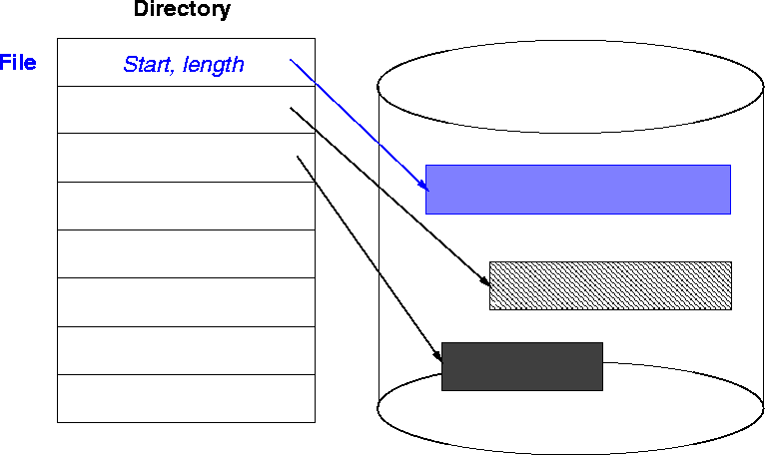
#1. Contiguous Allocation
Copyright ©: Nahrstedt, Angrave, Abdelzaher

Slide 4
Contiguous Allocation Issues
Copyright ©: Nahrstedt, Angrave, Abdelzaher
Access method suits sequential and direct access
Directory table maps files into starting physical address and length
Easy to recover in event of system crash
Fast, often requires no head movement and when it does, head only moves one track

Slide 5
Contiguous Allocation Issues
Copyright ©: Nahrstedt, Angrave, Abdelzaher
File is allocated large contiguous chunks
Expanding the file requires copying
Dynamic storage allocation - first fit, best fit
External fragmentation occurs on disk

Slide 6
External Fragmentation
Solution: Linked allocation
Copyright ©: Nahrstedt, Angrave, Abdelzaher

Slide 7
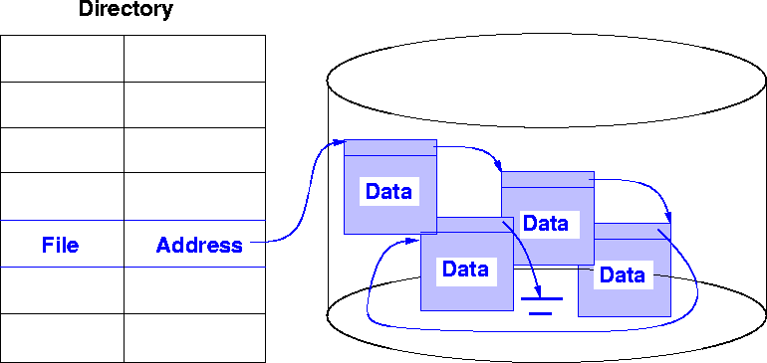
#2. Linked Allocation
Copyright ©: Nahrstedt, Angrave, Abdelzaher

Slide 8
Linked List Allocation
Copyright ©: Nahrstedt, Angrave, Abdelzaher
Each file is a linked list of nodes
Pointers in list are not accessible to user
Directory table maps files into head of list for a file
A node in the list can be a fixed size physical block or a contiguous collection of blocks
Easy to use - no estimation of size necessary

Slide 9
Linked List Allocation
Copyright ©: Nahrstedt, Angrave, Abdelzaher
Can grow in middle and at ends
Space efficient, little fragmentation
Slow - defies the principle of locality. Need to read through linked list of nodes sequentially to find the needed blocks of data
Suited for sequential access but not direct access

Slide 10
Linked List Allocation Issues
Copyright ©: Nahrstedt, Angrave, Abdelzaher
Disk space must be used to store pointers (if disk block is 512 bytes, and disk address requires 4 bytes, then the user sees blocks of 508 bytes)
Not very reliable. System crashes can scramble files being updated
Important variation on linked allocation method: `file-allocation table' (FAT) - OS/2 and MS-DOS

Slide 11
Linked List Allocation Issues
Copyright ©: Nahrstedt, Angrave, Abdelzaher
Summary: linked allocation solves the external fragmentation and size-declaration problems of contiguous allocation,
However, it can't support efficient direct access

Slide 12
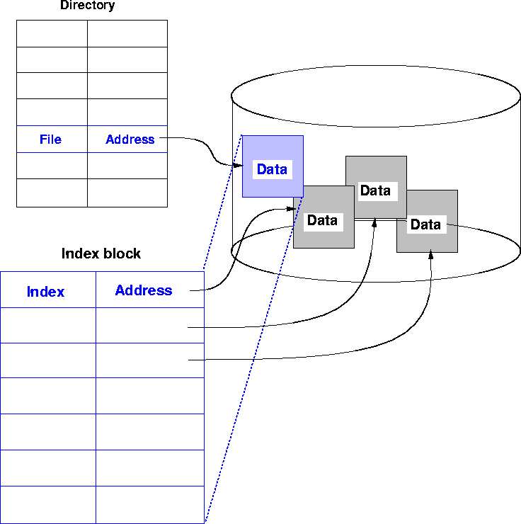
#3. Indexed Allocation
Copyright ©: Nahrstedt, Angrave, Abdelzaher

Slide 13
Indexed Allocation
Copyright ©: Nahrstedt, Angrave, Abdelzaher
Solves external fragmentation
Supports sequential, direct and indexed access
Access requires at most one access to index block first. This can be cached in main memory

Slide 14
Indexed Allocation
Copyright ©: Nahrstedt, Angrave, Abdelzaher
Requires extra space for index block, possible wasted space
How to extend to big files?
  A file can be extended by using linked indexed files or multilevel indexed files

Slide 15
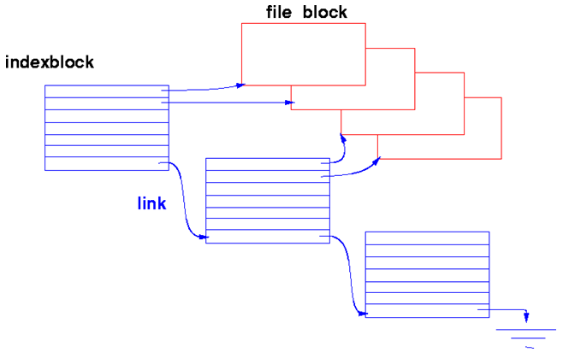
Linked Indexed Files
Copyright ©: Nahrstedt, Angrave, Abdelzaher
Link full index blocks together using last entry.

Slide 16
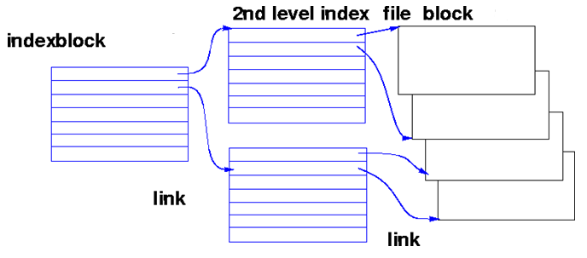
Multilevel Indexed File
Copyright ©: Nahrstedt, Angrave, Abdelzaher
Multiple levels of index blocks

Slide 17
Layout of a UNIX file on disk
Copyright ©: Nahrstedt, Angrave, Abdelzaher
File allocation is done on a block basis and allocation is dynamic (as needed).
UNIX uses a multilevel indexing mechanism for file allocation on disk. Addresses of first 10 data blocks + 3 index blocks (first, second, and third level of indexing)
In UNIX System V the length of a block is 1 Kbyte and each block can hold a total of 256 block addresses
According to above parameters, maximum size for a file is slightly over 16Gbytes

Slide 18
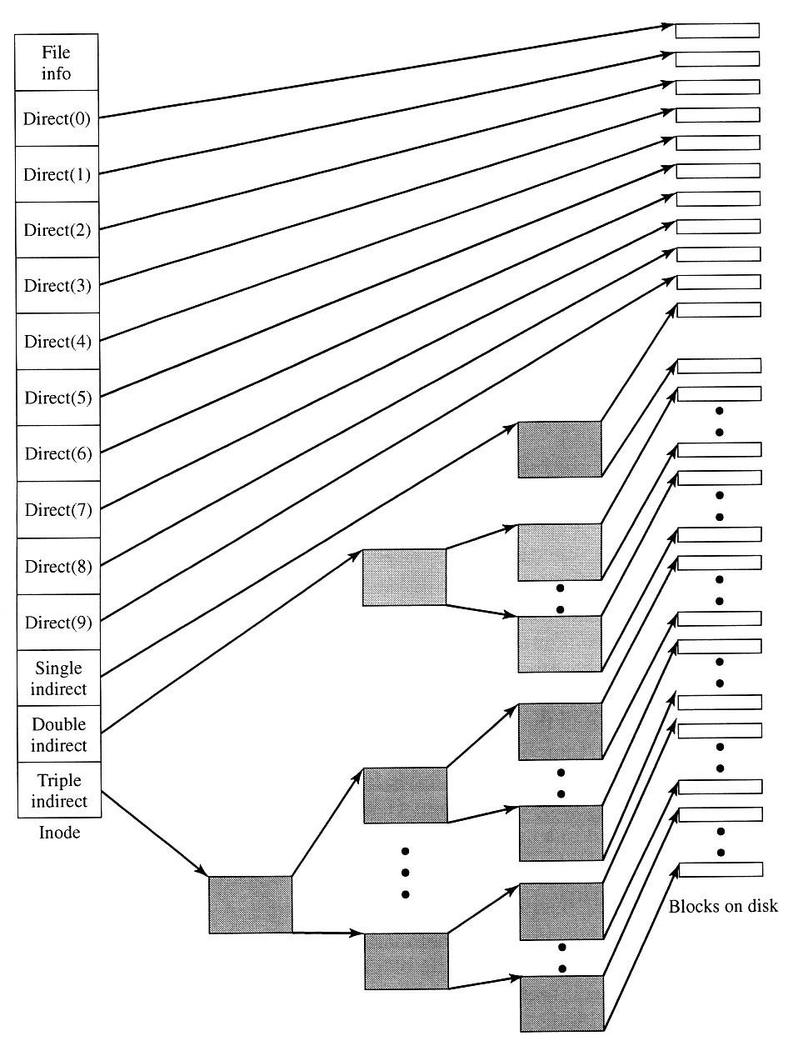
Layout of a UNIX file on disk
Copyright ©: Nahrstedt, Angrave, Abdelzaher
First ten addresses
point to the first 10
data blocks of the file
The inode includes 39 bytes
of address information that
is organized as thirteen 3-byte
addresses

